Slide 1
Watch Me Grow at NHFV presents…
Strengthening Social-Emotional Development through Screening

Slide 2
ABOUT NHFV
NH’s Family to Family Health Information Center. Staffed by trained parents of children and young adults. Our families represent the full experience of development and include family members with special health care needs / disabilities.

Slide 3
What is Watch Me Grow?

Slide 4
Watch Me Grow is NH’s developmental screening system.
Notes:
Watch Me Grow is NH’s Developmental Screening System is comprised of partnerships throughout the state to ensure high quality, accessible and coordinated developmental screening, information, and referrals to local agencies and/or child health providers so that all NH families and their children (birth through 5 years) receive the appropriate services and supports needed to grow, learn and to reach their maximum potential. Through coordinated efforts to increase screenings, create meaningful family connections, and improving overall outcomes through the use of data collection, it is the goal of Watch Me Grow to power up the health and wellbeing of all children in NH.
More simply put, the goal of WMG is to expand developmental screening in the state of NH and to improve outcomes for children identified as at risk for developmental delays. Here is a closer look at how we do this…

Slide 5
Watch Me Grow Steering Committee
Notes:
The implementation of WMG is dependent upon communication, coordination, and integration or resources and services. Genuine collaboration is required to make changes in policies, governance, and operating procedures at administrative and service levels. One of the first steps for developing WMG is enlisting partners who have mutual interests, service toward the same populations, and/or have the capacity to move agendas forward. The WMG steering committee has help guide WMG and increase the scale and spread of the project as its evolves.

Slide 6
Notes:
How do we achieve this goal?
We implement the National HMG Model.
32 out of 50 states use the HMG System model....
Data: Data collection and analysis ensure ongoing capacity for continuous system improvement, a key structural requirement of HMG. Data is collected throughout all components of the HMG system, including child health provider outreach, family and community outreach, and within the centralized access point.
The collection of a set of shared metrics across the HMG National Affiliate Network advances understanding of collective impact, informing the national narrative regarding the impact of HMG on children and families across the country. The collection of locally-sourced metrics enable HMG affiliates to benchmark progress, identify areas of opportunity and systemic gaps, determine potentially advantageous partnerships, and guide strategic quality improvement projects.

Slide 7
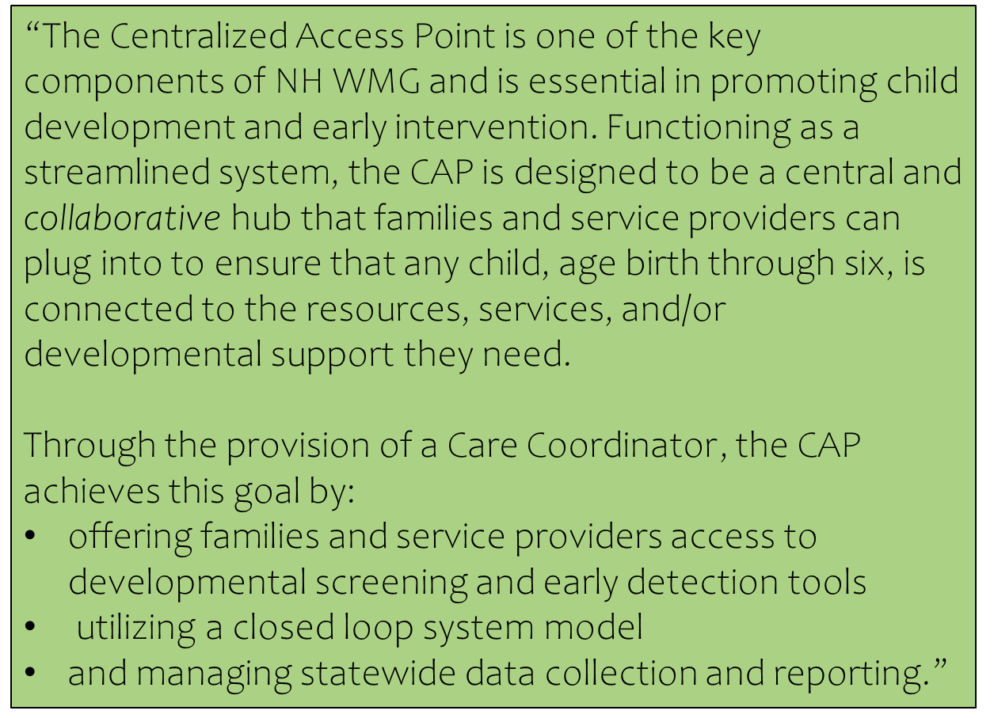

Slide 8
What the WMG Centralized Access Point can do for you:
Provide organizations with free printed materials (ASQ kits, ASQ learning activity books, LTSAE materials, and other developmental resources)
Provide ASQ training on above materials (in-person, online training portal, or training DVDs)
Assistance and ongoing support to organizations with developmental screening needs, information & referrals, as well as gathering information on whether services were received and if there was meaningful family connection.
Resource and materials coordination for families and/or providers
Screenings for families coming through the CAP
Up to date resources online and in print (Maneuvering through the Maze)
Access to NHFV’s Lending library
Resource and Referral information through calling/contacting NHFV
Reporting out of de-identified data to ensure quality system enhancement and improve outcomes for families and children statewide from the ground up.
In the future… Provide access to the ASQ Online Management System, cover the cost of each online screening, and provide ongoing technical assistance.

Slide 9
Notes:
ACTIVITY: Page 17… Comfort Levels
This segment of the presentation covers the ASQ:SE-2. The presenter will find guidance on facilitating exercises in the NOTES section, as well as information that expands on many of the slides.
Presenters can customize this presentation to meet the needs of their audience. It is encouraged to add to and/or delete sections depending on the needs of your training groups. For example, presenters can add local resources to the What’s Next/Resources section of the presentation.
In the Trainer’s Materials section of your handbook & USB, you will find guidance on facilitating scoring exercises and family studies. Presenters are encouraged to customize these family studies to reflect characteristics of your local community (or create your own family studies).
Also, in the Trainer's Materials section of the Trainer’s Handbook and also in the folder on the USB, there is a Training Activities Table that includes interactive training activities to incorporate into your training efforts.
The presentation can also be enhanced with video. The ASQ:SE-2 In Practice will be available to enhance your trainings.
Small group activity:
In groups, discuss why screening social and emotional development is important, especially during the early childhood years.
Spokesperson: Jot down ideas and prepare to share back to large group.

Slide 10
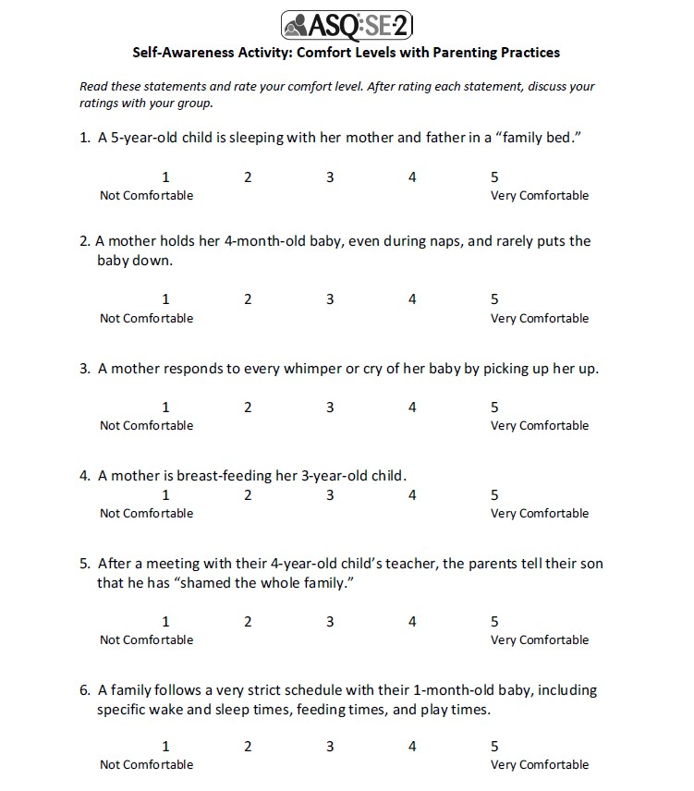
Notes:
ACTIVITY: Page 17… Comfort Levels
This segment of the presentation covers the ASQ:SE-2. The presenter will find guidance on facilitating exercises in the NOTES section, as well as information that expands on many of the slides.
Presenters can customize this presentation to meet the needs of their audience. It is encouraged to add to and/or delete sections depending on the needs of your training groups. For example, presenters can add local resources to the What’s Next/Resources section of the presentation.
In the Trainer’s Materials section of your handbook & USB, you will find guidance on facilitating scoring exercises and family studies. Presenters are encouraged to customize these family studies to reflect characteristics of your local community (or create your own family studies).
Also, in the Trainer's Materials section of the Trainer’s Handbook and also in the folder on the USB, there is a Training Activities Table that includes interactive training activities to incorporate into your training efforts.
The presentation can also be enhanced with video. The ASQ:SE-2 In Practice will be available to enhance your trainings.
Small group activity:
In groups, discuss why screening social and emotional development is important, especially during the early childhood years.
Spokesperson: Jot down ideas and prepare to share back to large group.

Slide 11
What is Screening?
Administration of a brief, accurate (valid) tool that:
Identifies children developing on-schedule
May identify children who would benefit from practice/support in specific areas
Identifies children at risk for developmental delays (DD) who should be referred for further evaluation
Answers the question:
Does the child need an in-depth assessment?
Notes:
ACTIVITY (optional): Identify Types of Screening Tools
Materials needed: Flipchart paper or whiteboard & markers
Ask participants to identify what types of screening tools they use in their agencies or receive themselves (hearing, vision, diabetes, cancer).
Ask participants to identify one word that typifies screening. Write these words down and discuss screening using those words. (Examples: quick, affordable, preventative, catches people who may need further evaluation)
Developmental Screening results can identify what developmental domain or behavioral area to focus intervention efforts on.
Examples of General Developmental Screening tools:
Ages & Stages Questionnaires®, Third Edition (ASQ®-3) , DIAL-3, Early Screening Inventory (ESI), Revised Developmental Screening Inventory (RDSI), Parent’s Evaluation of Developmental Status (PEDS).
Examples of Social Emotional Screening tools:
Ages & Stages Questionnaires®: Social Emotional, Second Edition (ASQ®:SE-2); Temperament and Behavior Scales (TABS), BITSEA (Brief Infant/Toddler Social-Emotional Assessment), Devereux Early Childhood Assessment (DECA)

Slide 12
What is Monitoring?
Monitoring is re-screening at set intervals of children not known to be eligible for special health or educational services
Answers the question:
"Is the child developing on-schedule over time?"
Notes:
Monitoring is not a type of assessment, but how we use it. By re-administering a screening over time, we check in through focused observations to assure developmental progress.
By re-administering screening tools such as the ASQ and ASQ:SE ( designed with many intervals), we can easily monitor children over time and make sure the child continues to develop typically.
ACTIVITY (Optional):
Question for participants: If a child’s development is ‘on schedule’ at one point in time, what events might cause concerning developmental changes? Answers: medical event, environmental stress, lack of developmental stimulation.
Question for participants: How can monitoring benefit "at-risk" children? Answer: can provide frequent check- ins to assure development is progressing on schedule and also provide education and support to parents to help them assure their child’s developmental progress.
Although many programs that serve young children only screen one time a year, best practice would encourage an initial screenings at 2 and 4 months. Screen every 4-6 months until age 2 years. Screen every 6 months until age 5 years. More frequent screening is suggested for children who experience a serious illness or when parents feel development has changed markedly (see page 40 in ASQ-3 User’s Guide).
For the ASQ:SE-2, monitoring recommendations are “every 6-12 months”, see page 105 in ASQ:SE-2 User’s Guide.
Note: If a child IS eligible for special health or educational services, typically screening is discontinued. There are a few exceptions discussed later, however, in general, the screening tool served it’s purpose (identifying a child in need of specialized services); and should not be re-administered.

Slide 13
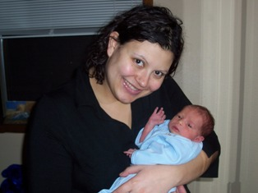
Engaging Parents
Why Parent Report?
Notes:
ACTIVITY: ASK GROUP TO SHARE EXAMPLES OF WHY PARENTS SHOULD BE INCLUDED IN THE SCREENING PROCESS. WRITE ANSWERS ON WHITE BOARD.
If online training, unhide next slide for breakout group activity.

Slide 14
Benefits of Parent Report:
Acknowledges parents as experts on their child.
Validates parent’s concerns
Empowers parents to advocate for child
Facilitates communication between provider and parent regarding child’s development
Educates parents about child development
Bridges communication and builds collaborative relationships with providers
Includes parents as active participants on child’s educational team
Notes:
Screening, assessment, and evaluation should be conducted in natural, non-threatening settings and involve tasks that are relevant to the child and family.
Children will demonstrate their true capacities when they are in a place that is secure and familiar, and with people whom they know and trust.
Infants and young children may be particularly sensitive to unfamiliar caregivers and separation from trusted adults.
The family is the primary force in preparing children for school and life (Henderson & Berla, 1995)
Children benefit when all the adults who care for them work together (Bronfenbrenner, 2004
Family members should be an integral part of the screening, assessment, and evaluation process. The child’s relationship and interactions with his or her caregiver should form the cornerstone of the assessment. Children will generally reveal their highest level of skills in the context of spontaneous, motivated interactions with caregivers. The evaluator can build on these interactions by coaching the parent to elicit certain behaviors or skills or by joining in the interaction.
The important role of family-mediated strategies in early intervention is well accepted as evidenced by the inclusion of parenting competencies in early intervention theories of practice (Odom & Wolery, 2003), the recommended practices of the Division of Early Childhood of the Council for Exceptional Children (Trivette & Dunst, 2005)
Using a parent completed measure to screen young children is a family-centered practice. Ensuring parent involvement and responsiveness is a necessary component of early intervention without which child directed intervention services are unlikely to be effective (Mahoney, 2009).
Practices aimed at promoting positive parenting practices, teaching parenting skills, and influencing parent child interactions have demonstrated associations with positive social emotional development for children aged 0-3 years.

Slide 15
What are ASQ:SE-2?
Series of parent/caregiver completed questionnaires for children 1 to 72 months.
Tool to support early identification of young children at risk for social-emotional delays and identify what support caregivers may need.
Tool to identify and respond to parent concerns early, so child’s behaviors don’t become barriers to healthy relationships, and in turn, a healthy future.
Notes:
Page 2 has Age administration chart
Parents complete questionnaires based on their observations and experiences with their child during their daily routines. Other caregivers may complete an ASQ:SE but they must have at least 15-20 hours contact/week with child.
The earlier we can identify social-emotional delays and/or behaviors that are of concern to a parent the more we can support a healthy relationship between children and their primary caregivers.
A main function of the ASQ:SE-2 is to link families with resources in the community based on real needs.

Slide 16
Versatile, Cost-effective Tools
Flexible methods to complete
face-to-face, telephone or virtual, online, mail-out
Variety of settings
home, early learning /school, clinic
Cost effective
parent-completed; reproducible or electronic forms
Notes:
The original tool was developed as a mail-out questionnaire for NICU graduates. However, over time, these tools have been used in a variety of settings; and using a variety of methods to administer.
Refer to the ASQ-3 User’s Guide and ASQ:SE-2 User’s Guide for detailed information and considerations about using these tools in different settings or methods.

Slide 17
Features of ASQ:SE-2
2, 6, 12, 18, 24, 30, 36, 48, and 60 month intervals
From 19 scored questions (2 mo) to 39 scored questions (60 mo)
1–6 month administration window
Uses adjusted age for children born 3 weeks or more premature until the child is 2 years old
Notes:
MONITORING SCHEDULE: By using each and every interval, a child’s emerging social emotional skills can be monitored. Each of these age ranges captures different stages of social-emotional development that may be stressful for parents. Some parents love babies but struggle with toddlers. Some are more comfortable with preschool age children. Checking in on a regular schedule helps parents reduce their parenting stress and becomes a critical intervention.
The ASQ:SE-2 has wider administration windows than ASQ-3. Many behaviors assessed on ASQ are skills such as crawling that are present for a short period of time and then become something different (e.g., walking). This is different from "competence" behaviors on the ASQ:SE-2 that once they are present, hopefully will stay with a child forever. On the flip side, "problem" behaviors can be reduced with support.
The number of items and content of items change across the ages. 26 scored questions in 6-month ASQSE; up to 39 questions on 48-month ASQ:SE

Slide 18
Features of ASQ:SE-2
All questionnaires are written at 4th- to 6th- grade reading level
All questionnaires include open-ended questions related to:
eating, sleeping, and toileting concerns
Any additional worries
What caregivers enjoy about their child
Notes:
Participants should have the ASQ:SE-2 Questionnaire for review.
“Louis 6 Month Questionnaire” found behind the ASQ:SE-2 Handouts tabbed section of the Trainer’s Handbook/USB.
Open-ended questions are not scored.
The open-ended questions on ASQ:SE-2, just like the Overall Section on ASQ-3, are very important. Referrals are often made based on an answer to an overall question, regardless of the total score of ASQ:SE-2.
Any concern that is brought up in this section should be addressed.

Slide 19
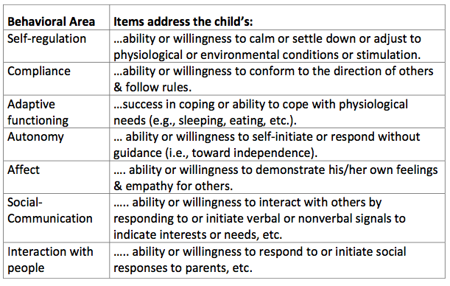
Areas of ASQ:SE-2
Notes:
Questions on the ASQ:SE address the following behavioral areas:
Self Regulation: Items address the child’s ability or willingness to calm or settle down or adjust to physiological or environmental conditions or stimulation.
Compliance: Items address the child’s ability or willingness to conform to the direction of others and follow rules.
Adaptive functioning: Items address the child’s success in coping or ability to cope with physiological needs (e.g., sleeping, eating, elimination, safety).
Autonomy: Items address the child’s ability or willingness to self-initiate or respond without guidance (i.e., move toward independence).
Affect: Items address the child’s ability or willingness to respond to or demonstrate his or her own feelings and empathy for others.
Interaction with People: Items address the child’s ability or willingness to respond to or initiate social responses to parents, other adults, and peers.
Social Communication: Items address the child’s ability or willingness to interact with others by responding to or initiating verbal or nonverbal signals to indicate interests or needs, feelings, affective, or internal states.
Understanding the definitions of these areas helps understand the intent behind the questions on the ASQSE.

Slide 20
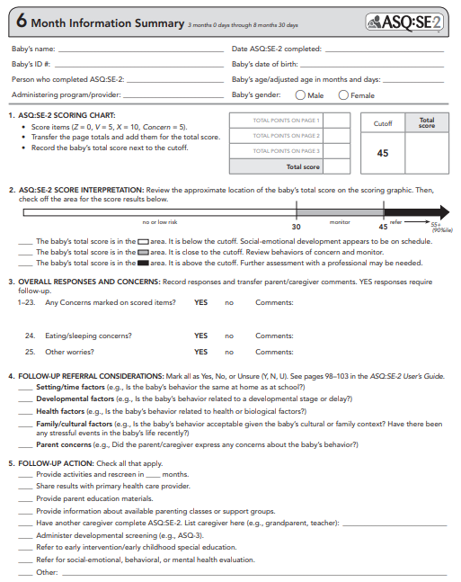
Features of ASQ:SE-2
Summary Sheet
Notes:
Each ASQ:SE-2 interval has unique Information Summary sheet that resemble the ASQ-3 Information Summary sheet but with only one area or bar to report.
The summary sheet, along with the optional “Item Response Sheet” provides a summary of the entire ASQ:SE-2, as well as follow-up actions that are needed. All information can be transferred to this page and shared with other providers once consent has been established. It also allows the provider to leave the questionnaire with families, increasing educational impact of tool.
Each Summary sheet has 6 sections:
Child/family information
Score total
Bar graph with cutoffs
Overall section
Follow-up considerations
Follow-up action taken
Reference the “ASQ:SE-2 6 Month Item Response Sheet” found in the ASQ:SE-2 Handouts tabbed section of the Trainer’s Handbook/USB. Note that this form is available for all age intervals on the CD-ROM that is part of the ASQ:SE-2 Starter Kit; they are found in the ”Scoring Sheets” folder.

Slide 21
6 Month ASQ:SE-2 Cutoff Chart
Monitor area 65th Percentile
Cutoff
End of Chart 90th Percentile
Notes:
Monitor Area: Each monitor area of the ASQ:SE-2 begins at the 65th percentile (on the 6 month ASQ:SE-2 at 30 points) and ends at the statistically derived cutoff score (45 points). The 65th percentile is the point at which 65% of the normative sample scored below that score.
The cutoff for the ASQ:SE-2 6 Month Questionnaire is 45. Any child with a total score greater than 45 should be referred for an appropriate individualized follow-up.
90th Percentile. The 90th Percentile score is indicated at the end of each ASQ:SE-2 Cutoff Chart. It provides additional information about score distributions of each interval, and the point at which 90% of the normative sample scored below.

Slide 22
Interpreting Results/
Factors to Consider
Notes:
Page 21 and 22: Factors to Consider
*NOTE that this follow-up consideration section is specifically from the 6 month summary sheet**
HANDOUT: “Factors to Consider Before Beginning the Referral Process” When results are in the monitor or referral areas of the ASQ:SE and providers are unsure of appropriate next steps, this handout provides a questioning process that helps generate next steps.
Before making behavioral health referrals, it may be more appropriate for staff to gather more information; provide family support; make other community referrals (health care; EI/ECSE), use preventive measures and closely monitoring the child’s behavior.
Example: A child with a speech delay may feel frustrated when unable to communicate his or her needs and react negatively (e.g., by pushing and hitting other children). Rather than immediately referring the child to a behavioral specialist or mental health provider, a more appropriate first step may be a referral to an EI/ECSE program for an evaluation by a speech-language pathologist. Addressing speech needs may help reduce behaviors.
Three reasons to gather additional information when analyzing a young child’s behavior:
A child’s behavior may depend on a variety of time/setting, developmental, health, and cultural/family factors.
Diagnostic assessments are expensive and time consuming
Diagnostic assessments can be stressful for the child and family
The ASQ:SE-2 Information Summary sheet has a section to indicate that these factors have been considered. In considering these factors, follow-up actions can be clear.

Slide 23
Interpreting Results
Factors to consider before making follow-up decision
Time/Setting:
Examples of Follow-Up
Have another caregiver fill out ASQ:SE
Analyze caregiving environment to determine if supporting or compromising child’s behaviors
Provide parenting support and education to the parent in the home environment
Consider a functional behavioral analysis to determine function of behavior and create positive behaviorial support plan
Does child act same way at home and in child care or preschool?
Is the setting new or unfamiliar to the child?
Is the setting a good match for the child’s temperament?
Is the child reinforced for certain behaviors?

Slide 24
Interpreting Results
Factors to consider before making follow-up decision
Development:
Examples of Follow-Up
Is behavior related to developmental stage?
Can behavior be attributed to a developmental delay or SPD?
Are child’s skills at age level in the following domains? (FM, GM, problem solving, communication, personal-social)
Provide developmental information (e.g. SE development guides, activities), positive behavior management suggestions, etc
Screen using the ASQ-3
Refer child to early intervention or special education agency if concerned or screening tool indicates a need for further evaluation

Slide 25
Interpreting Results
Factors to consider before making follow-up decision
Health:
Examples of Follow-Up
Is the child’s behavior related to health of biological factors?
Has the child had a recent medical checkup?
Have the following been considered as behavioral influences? (Lack of sleep, hunger, meds, allergies, exposure to drugs in utero, etc)
Refer child to his or her PCP. Addressing behavioral concern to determine if there is a biological/medical cause, and make referrals or follow-up as indicated within the health system
Keep in close contact with family regarding all aspects of child’s health

Slide 26
Interpreting Results
Factors to consider before making follow-up decision
Examples of Follow-Up
Family/Culture:
Determine if language or translation issues may be influencing parents responses to items (misunderstanding intent)
Work with family directly to understand, or consider a community health worker or cultural broker to determine if behavior is within cultural norm
Support parent’s understanding of SE needs of young child; provide resources on services available to parent
If child has moved to a new safe & nurturing environment, consider waiting before referring. If unsafe or neglectful environment, refer child to CPS or other services.
What is the child’s native language?
Is the “problem” behavior within the cultural norm for this child’s family?
Is the parent/child relationship influencing the child’s ASQ:SE-2 results?
Has the child been affected by stressful or traumatic events (ongoing, past, present)?

Slide 27
Interpreting Results
Factors to consider before making follow-up decision
Parent Concerns:
Examples of Follow-Up
Did the parent or caregiver express any concerns about child’s behavior?
What is the intensity and frequency of behavior or concern?
Are individual factors of parent or child (e.g. temperament) related to parent’s concerns?
Is the behavior typical or atypical given the child’s developmental stage?
“Can you tell me more about?”
Provide developmental information, parenting education/support, etc
Listen carefully to all parent concerns. Support parent in identifying and accessing resources and supports within community to address concerns (e.g. support agencies to access basic needs such as food/housing, respite care, counseling, etc)
Refer child for behavioral or mental health eval. if concerns persist and are atypical for child’s age

Slide 28
Interpreting Results
If concerns about child behavior persist after factors have been considered, refer the child (with parental consent) for a early childhood behavioral or mental health evaluation
Notes:
Parents may overuse the "sometimes" column and this results in an inflated score. You may review those items and rescore with the parent if warranted. Be careful to not impose your perspective.
ASQ:SE2 has subjectivity (caregiver’s feelings, opinions, personal perspective) inherent in its design. It may be helpful to get input from other caregivers. You can suggest having other caregivers (e.g., grandparents, other parent) or service providers (e.g., teachers) complete an ASQ:SE-2. Remember that you should spend 15-20 hours or more each week with the child to know them well enough to complete a questionnaire as a provider.
QUESTION for Participants:
When the child is a concern for only one caregiver, but not another, what information does this give us?
ANSWER: the stress is with the parent reporting concerns. This is the parent who needs support and guidance.
If a child is a concern for everyone, what does that imply?
ANSWER: the concerns rise; behavioral concerns that occur in multiple settings, with multiple caregivers, indicate potential problems that require more urgent referrals and in-depth evaluation.
With higher risk parents it may be important to provide extra support.
If you have a concern about validity or accurate reporting, suggest an alternate administration method (interviewing)
Suggest another caregiver complete an ASQ:SE-2. Referrals can be recommended if concerns arise from other caregivers as well.
Positively discuss how a child performs in different settings, helping adults understand how environments or interactions impact a child’s behavior.
Continue to use information from ASQ:SE-2 as a communication tool with the parent and as a guide to focus resources, support and guidance for specific areas of stress or concern.
Simultaneously, it is important that a family is guided to professionals who can sort out issues that may be beyond abilities of current providers.

Slide 29
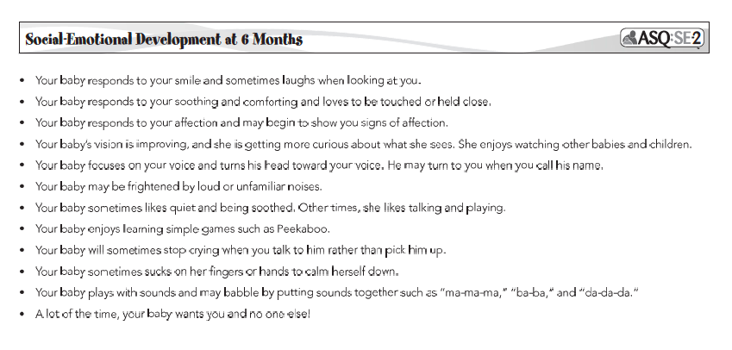
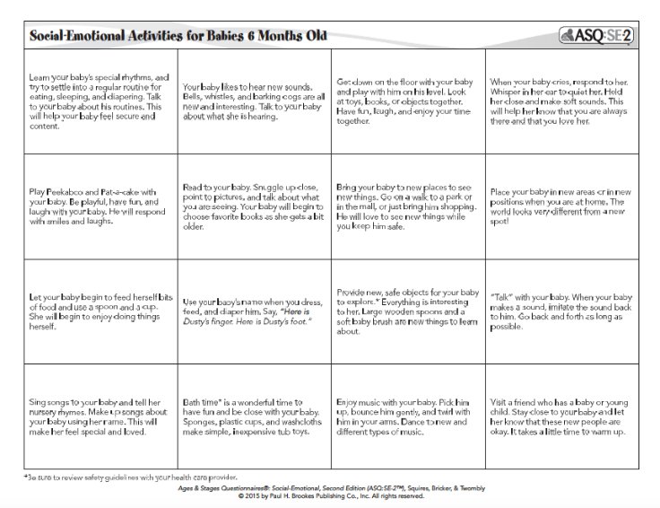
Recommended Follow-up
(HANDOUTS: ASQ:SE-2 Activities and Developmental Guidance)
Result is “on-schedule” (below Monitor area)
Provide ASQ:SE-2 activities and monitor
Follow-up on any parent concerns
Notes:
In the ASQ:SE-2 User’s Guide Appendix E contains Social-Emotional Development Guides (pgs. 241-258) and Intervention Activities (pgs. 259-276).
The response to a parent’s concerns is often simply offering parenting information and support, but may also entail linking parent’s with more comprehensive concrete mental health, parenting, child health or educational services.

Slide 30
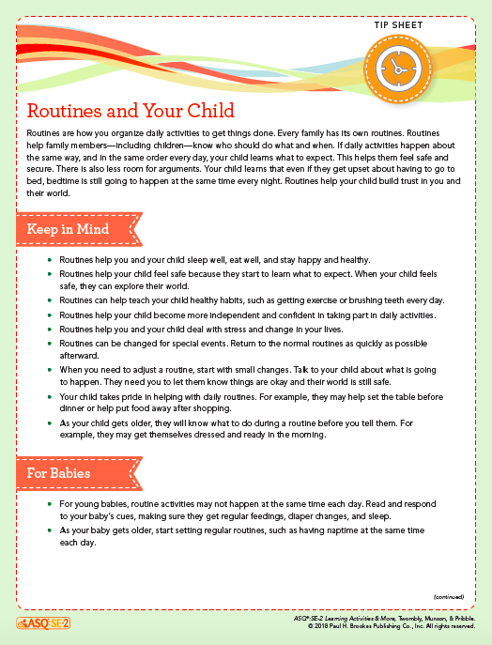
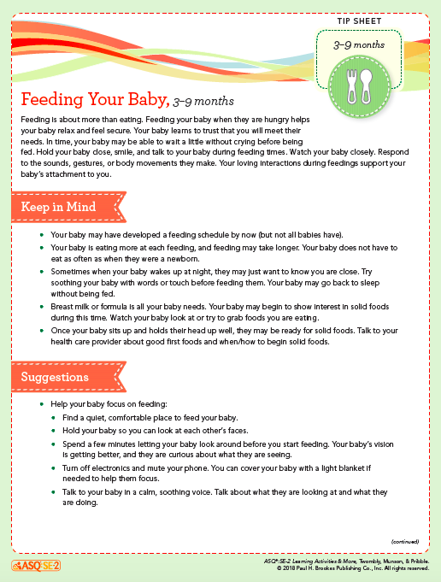
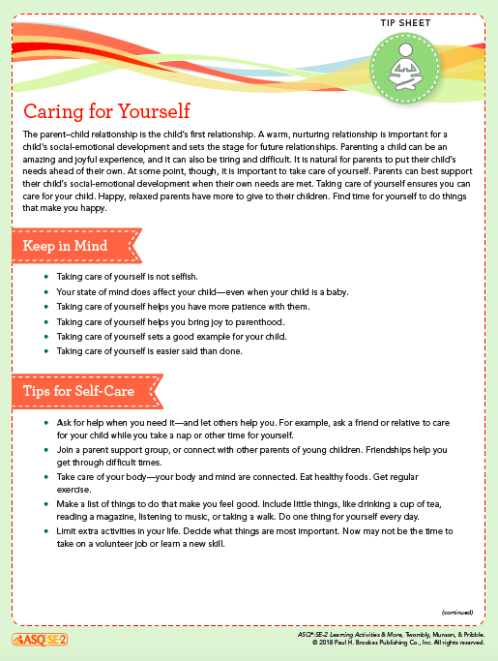
Recommended Follow-up
Result is in Monitor area
Follow up on concerns
Provide information, education, and support and re-administer ASQ:SE-2
Consider referral if results indicate lack of competence behaviors
Notes:
The ASQ:SE-2 Learning Activities & More contains newsletters, activities and parenting tips arranged by age and by ASQ:SE “area” (e.g., self regulation) . This book is available to purchase in both English and Spanish.
The response to a parent’s concerns is often simply offering parenting information and support, but may also entail linking parent’s with more comprehensive concrete mental health, parenting, child health or educational services.

Slide 31
ASQ:SE-2 Learning Activities
LA Resources for Self-Regulation.
Age-Appropriate Newsletter
Age-Appropriate P/C activities
Calming Tip Sheet
Special Topic Tip Sheets:
Calming a Colicky Baby
Caring for Yourself
Media and Technology
Routines and Your Child
Stress and Your Child
Positive Discipline
Notes:
This slide provides an example of the types of resources available in the ASQ:SE-2 Learning Activities & More book as organized by Behavioral Areas of the ASQ:SE-2.

Slide 32
Examples of Recommended Follow-up
Result is in Referral area (above cutoff)
Provide ASQ:SE-2 learning activities and monitor
Refer to primary health care provider
Consider referral to local community agencies:
Parenting groups/Home Visiting
Early Head Start/Head Start
Feeding/Sleeping clinics
Faith based groups
Refer to EI/ECSE
Refer for Behavioral Health evaluation
Notes:
The majority of above cutoff follow-up recommended is often local early childhood and community linkages that support family well being and are preventative in nature.
It is important to consider your state/community resources when providing follow-up.
Follow-up options can range from teaching the parent about developmental expectations, or establishing consistent routines, to referral for the child to a licensed mental health practitioner.

Slide 33
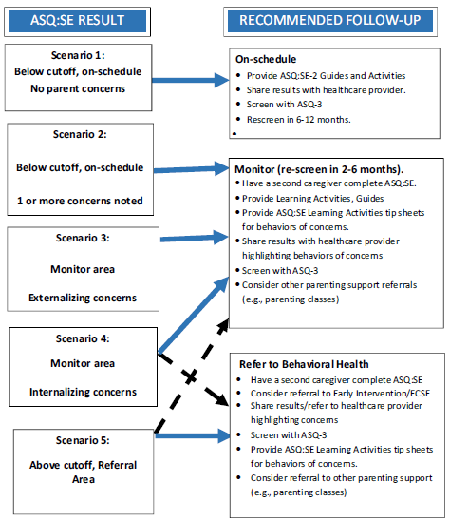
Map of ASQ: SE-2 Follow-up
Notes:
The majority of above cutoff follow-up recommended is often local early childhood and community linkages that support family well being and are preventative in nature.
It is important to consider your state/community resources when providing follow-up.
Follow-up options can range from teaching the parent about developmental expectations, or establishing consistent routines, to referral for the child to a licensed mental health practitioner.

Slide 34
Follow Up to Screening: Support family to take next steps
√
2
√
√
√
√
Refer to doctor for tummy and feeding issues
Notes:
This is an example of possible follow-up steps for the Louis family activity
READ OVER THE TRAINERS NOTES FOR THIS CASE STUDY

Slide 35
Review Completed Questionnaire in Preparation for Parent Conference
Identify child’s strengths (“Z” Items)
Explore items marked ‘Sometimes’
Prepare to discuss 10 and 15 point items.
Review open-ended questions
Review ‘Factors to Consider’
Prepare for further inquiry.
Consider potential next steps
A well prepared, guided conversation with parent becomes a service that includes inquiry, investigation, and follow-up ideas.
Notes:
Begin the conversation with the child’s strengths. Items that received 0 points (marked with Z) are social-competence strengths and can be highlighted for parents. The last open-ended question also asks parents what they enjoy most about their baby.
Next, review items that received 10 or 15 points. These will include items marked with an X or V plus a parent concern OR might be an item marked with an X with no concern (why not?). Discuss parent concerns (or lack of concerns). “Can you tell me more about….” Encourage users to take notes while reviewing ASQ:SE with parents. If the item was clearly misunderstood, changes can be made to the scoring.
Review open-ended questions. The open-ended questions on ASQ:SE-2, just like the Overall Section on ASQ-3, are very important. Referrals are often made based on an answer to an overall question, regardless of the total score of ASQ:SE-2.
It is important to have conversation with a parent when they have expressed concerns for 3 reasons:
Parents will need to inform and direct any referral process
Parents are a critical source of information about factors discussed in the previous section that may affect a child’s ASQ:SE-2 results.
Gathering additional information will help staff make informed decisions about what follow-up steps need to be taken.

Slide 36
Discussing Results
When concerns arise
Consider where the family is in the process:
Parents may be relieved and ready or....
Upset, disagree and not ready to accept results
Listen, read subtle cues. Reflect back
If you share concerns, be specific
Review factors to consider (e.g., health)
Support, guide, and inform parents about resources.
You do not need to convince parents to refer
Support parent in referrals when they are ready
Re-screening is a good option and gives parent time
Notes:
Page 15: Tips for Discussing Screening Results
It is important to follow-up with ASQ users about how these conversations are going. ASQ users should be provided continual support to practice ‘ talking points’, especially when results show concerns.
A ‘specific concern’ that ‘reflects’ back what the parent has reported, may sound like:
“You say here that Andrew has had a lot of ear infections and is not responding to language as well as you’d expect. Based on what you reported in the questionnaire, his words are not coming yet. Checking a child’s hearing is a first step. Hearing problems can cause language delays. Do you think it would be helpful to get a hearing evaluation?”

Slide 37
In Summary: The Benefits of Developmental Screening
Identifies children with developmental concerns and connects them to further evaluation and community resources/services.
Bridges communication/builds relationship between families and providers
Developmental promotion: helping families understand, keep track, and maintain their child’s developmental history.
Developmental promotion: Educates families about milestones, provides tools to encourage and monitor healthy development, and highlights the importance of creating environments/learning opportunities conducive to early childhood growth.
Encourages early childhood professionals to use screening as a first indicator for potential developmental delay
Provides reliable community data that can be used for future planning, advocacy efforts, and quality system improvements.

